Slide 1
Dragutin Avramovski-Gute
Modern Macedonian art

Slide 2
Dragutin Avramovski-Gute
Dragutin Avramovksi – Gute was born in Kumanovo, on 11th March, 1931, and he passed away on 12th September, 1986.
He was a prominent Macedonian academic painter and graphic artist.
He had a special contribution to the development of the contemporary graphical expression in Macedonia.
He worked on set design and illustration.

Slide 3
Creativity of Dragutin Avramovski-Gute
Dragutin Avramovski – Gute is one of the most deserving artists for the development of the graphic art into the Macedonian painting. The Faculty of Art annualy awards the prize “Dragutin Avramovski – Gute” to their students for the best graphic work.
He is one of the ten Macedonian artists who involved in the process of faster release of Macedonian art from the conventions of the academic painting and embraced the variants of the abstract expression in the fifties and the sixties in the last century.

Slide 4
Works of Dragutin Avramovski-Gute
“Gothic Cathedral”, 1961; “Red Accents”, 1965; “Composition 1”, 1974; “Composition 2”, 1976; “The Dead Town, Stobi”, 1965; “Painting”, 1963; “My World”, 1966; “Head”, 1965

Slide 5
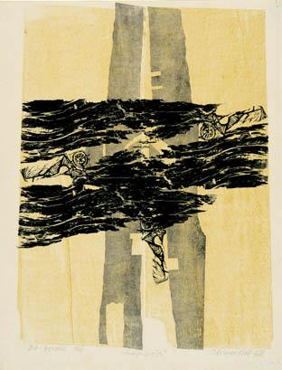

Slide 6
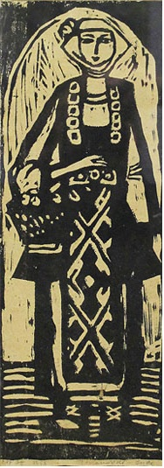

Slide 7
